Slide 1
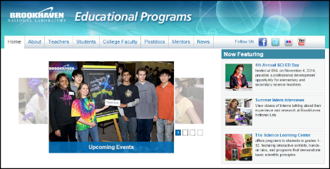
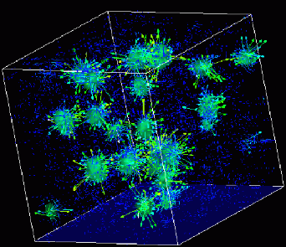

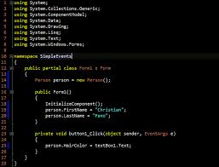
Advanced
Scientific Computing
(SciComp 201)
Session 30 Combinatorics

Slide 2
Session Goals
Review the five most common “combinatorics” used in scientific computing:
Permutations – order is important, no repetitions
Combinations – order is not important, no repetitions
Variations – the “Permutations of a Combination”
Partitions – all subsets of a specified size
Restricted Partitions – partitions satisfying a constraint
Develop algorithms to generate all five entities

Slide 3
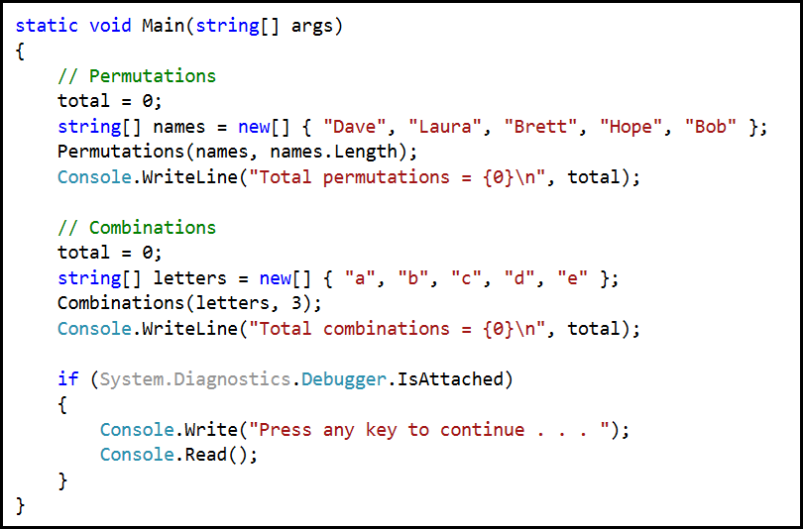
Lab 1 – Main()

Slide 4
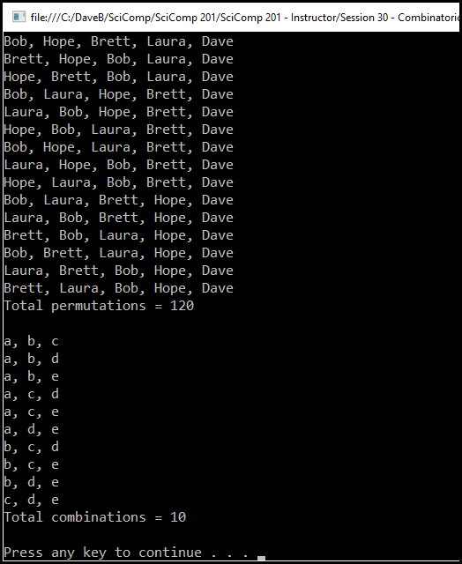
Lab 1 – Main()

Slide 5
Permutations
[6,11,18] permute = {{6, 11, 18}, {6, 18, 11}, {11, 6, 18}, {11, 18, 6}, {18, 6, 11}, {18, 11, 6}}
Permutations produce all of the possible arrangements (in a specific order) for the items in a given set

Slide 6
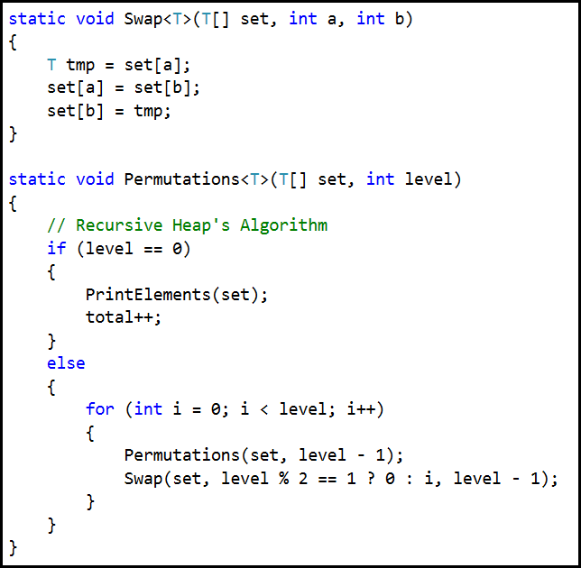
Lab 1 – Permutations

Slide 7
Combinations
Unlike with permutations where order is important, in a combination, order is not important, so we have to rule out duplicates
Instead of producing sets of “copies” of the items, the following algorithm produces sets of “indexes” which point to the actual item in the original array/vector

Slide 8
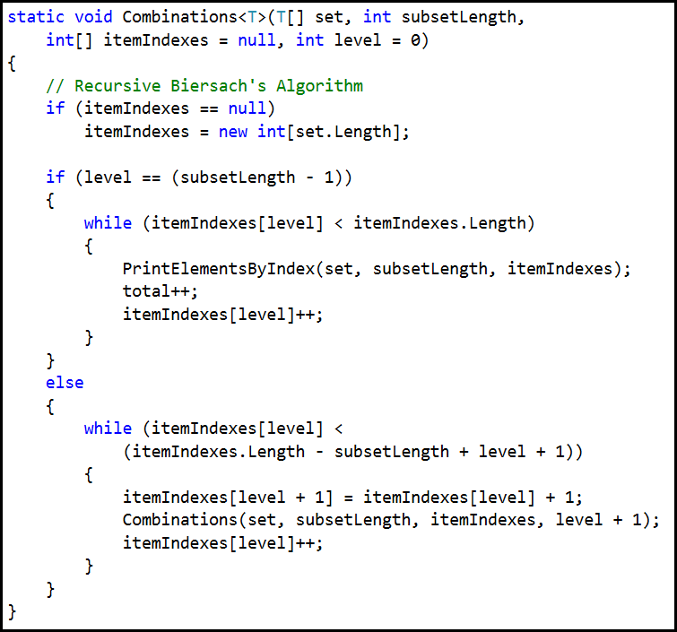
Combinations

Slide 9
Lab 2 - Variations
Given set [a,b,c,d] enumerate 4 chose 3
4 items in result set
{a,b,c} {a,b,d} {a,c,d} {b,c,d}
Then permute each item in the set of combinations
First set returned [a,b,c] permuted = 6 items
{a,b,c} {a,c,b} {b,a,c} {b,c,a} {c,a,b} {c,b,a}
The permutation of a combination is called a variation

Slide 10
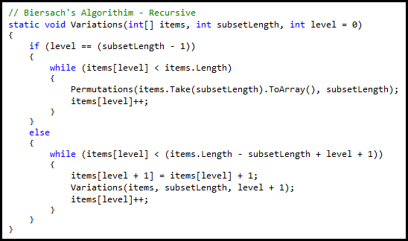
Lab 2 - Variations

Slide 11
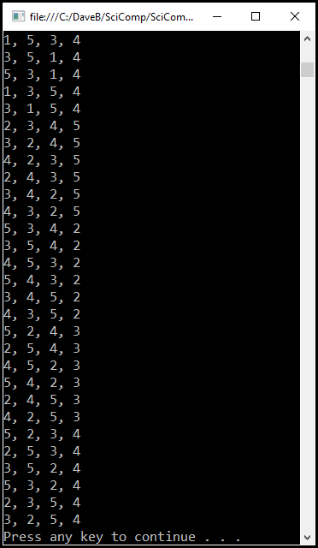
Lab 2 Variations

Slide 12
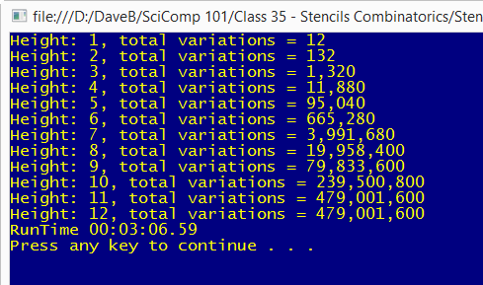
Feuerstein's Stencils

Slide 13
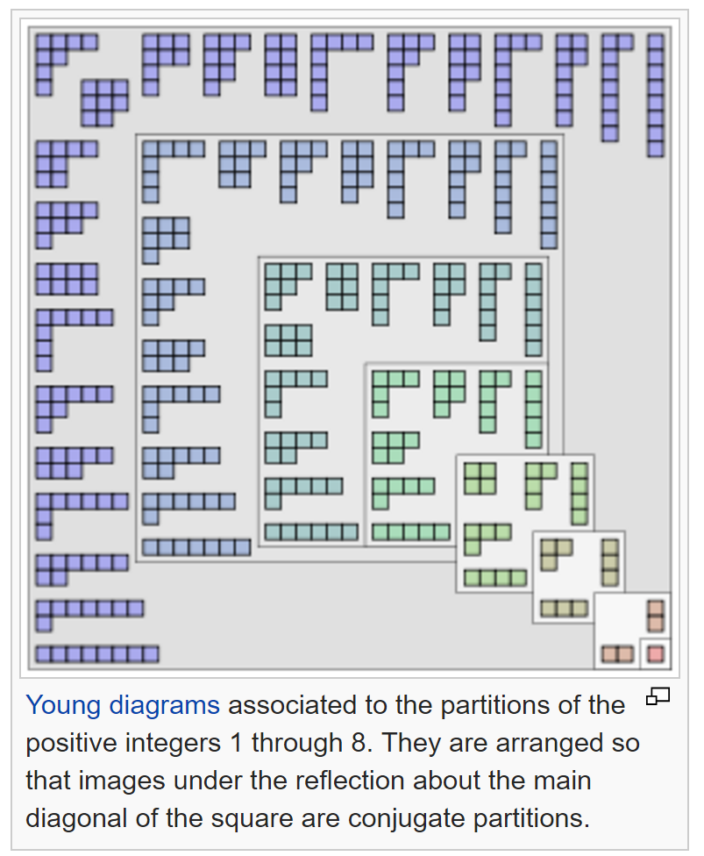
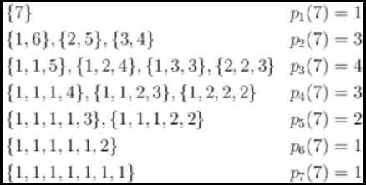
Lab 3 - Partitions

Slide 14
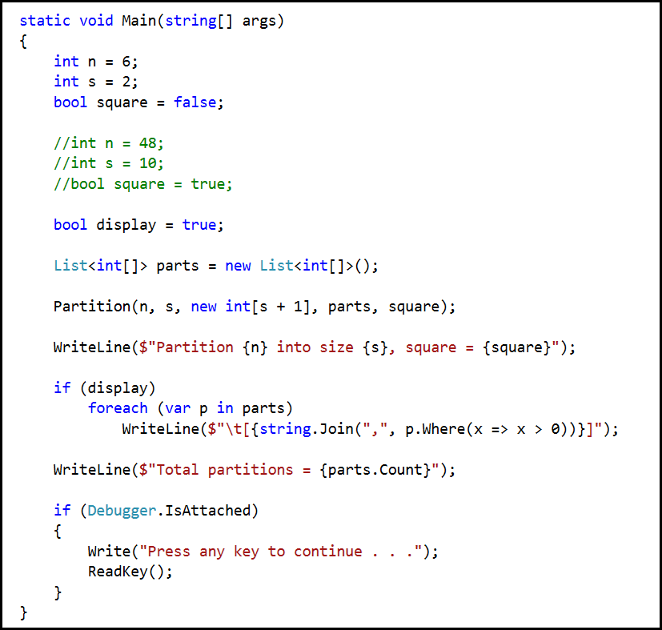
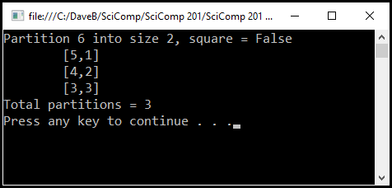
Lab 3 Partitions

Slide 15
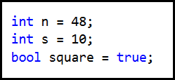
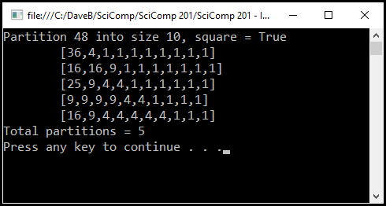
Lab 3 Partitions

Slide 16
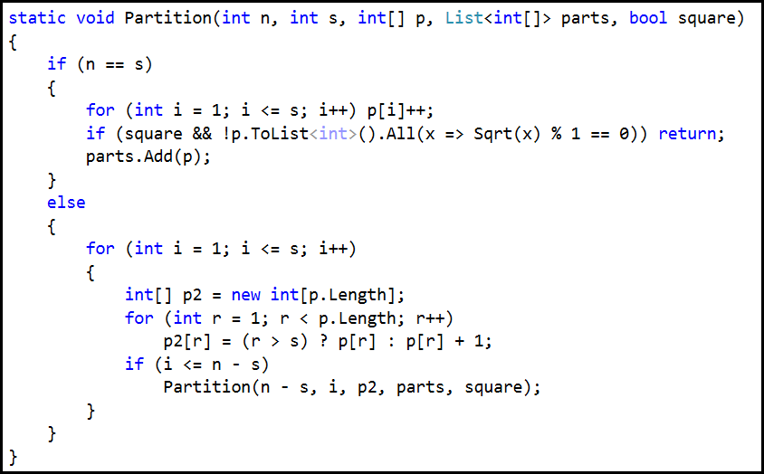
Partitions

Slide 17
Lab 4
Develop a C++ console application that displays the permutations and combinations of a vector<string>
Assume for permutations that user wants to display all permutations of a set where each permutation contains all the items of the set exactly once

